Slide 1
PROJECT PRESENTATION
Visual Product Similarity &
Image-Based Recommendation System
(Amazon-Style)
Domain: E-Commerce | Model: ResNet50 + FAISS
Prepared by
Lakshana Murugesan

Slide 2
Problem Statement
Online marketplaces host millions of products where textual metadata (title, description, tags) is often noisy, incomplete, or misleading.
✕
Keyword Search
"blue floral top" misses visually
identical items tagged differently
Traditional keyword-based search fails when users want visually similar products — same style, color, or design.
✓
Visual Search
“Customers who viewed this item also viewed” “Similar items” → Images matter more than text.
Upload an image → instantly find
visually matching products
Visual Product Similarity & Image-Based Recommendation System
Lakshana Murugesan

Slide 3
Business Use Case — How Amazon Uses This
🔍
Image-based product search
Upload an image → find similar items instantly
🧭
Better product discovery
Works even when text search fails to surface results
📈
Higher conversion rate
Recommending visually relevant products drives purchases
🗂️
Less metadata dependency
Reduces reliance on manually curated product tags
🛋️
Better UX across categories
Fashion, furniture, accessories, and home décor
Visual Product Similarity & Image-Based Recommendation System
Lakshana Murugesan

Slide 4
Objective
01
02
03
04
Extract
Retrieve
Rank
Scale
High-quality visual embeddings from product images using deep learning
A fast similarity search engine to find visually similar products
And return Top-K similar products for any input image
Demonstrate a production-like recommendation pipeline
Visual Product Similarity & Image-Based Recommendation System
Lakshana Murugesan

Slide 5
Approach — 5-Step Pipeline
1
2
3
4
5
Feature
Extraction
Embedding
Indexing
Similarity
Matching
Ranking &
Filtering
Evaluation
ResNet50 (FC layer
removed) → 2048-d
embedding vector
→
Store vectors, build
a FAISS cosine-
similarity index
→
Extract query embedding,
search FAISS for
Top-K neighbors
→
Rank by similarity
score; filter by
category
→
Precision@K, Recall@K,
and visual
inspection
Visual Product Similarity & Image-Based Recommendation System
Lakshana Murugesan

Slide 6
Tech Stack
🐍
🔥
🧠
⚡
Language
DL Framework
Model
Similarity Search
Python 3.10
PyTorch / TorchVision
ResNet50 (pretrained, FC layer removed)
FAISS — IndexFlatIP
📐
🗃️
🖥️
📦
Distance Metric
Metadata Store
Frontend
Dataset Source
Cosine Similarity
SQLite (normalized, indexed)
Streamlit
Kaggle API
Visual Product Similarity & Image-Based Recommendation System
Lakshana Murugesan

Slide 7
Dataset
Kaggle — “Fashion Product Images (Small)”, a public, industry-accepted e-commerce dataset with structured category metadata.
Source Images
44,441
Images were grouped by article type (Shirts, Jackets, Watches, Handbags, …), keeping categories with ≥15 images and sampling up to 40 per category — balancing dataset size against fast CPU embedding extraction.
2,000
Images Indexed
50
Product Categories
1,000+
Min. Recommended
Visual Product Similarity & Image-Based Recommendation System
Lakshana Murugesan

Slide 8
System Architecture
🖼️
🧠
⚡
🗃️
🖥️
→
→
→
→
Product
Images
ResNet50
Embeddings
FAISS
Index
SQLite
Metadata
Streamlit
UI
Query image in → embedding extracted → cosine-similarity search → ranked Top-K results out, in under a second.
Visual Product Similarity & Image-Based Recommendation System
Lakshana Murugesan

Slide 9
Results & Evaluation
0.6676
0.0856
Sub-second
Precision@5
Recall@5
Search Latency
~3.3 of every 5 results
share the query's category
~67% of the theoretical
max achievable at K=5
Exact FAISS
IndexFlatIP search
Evaluated on all 2,000 indexed products (each used as its own query, excluding itself); same-category images treated as ground-truth relevant items.
Qualitative: visually coherent recommendations (same style, color, structure) — confirmed via real product-image queries in the Streamlit app.
Visual Product Similarity & Image-Based Recommendation System
Lakshana Murugesan

Slide 10
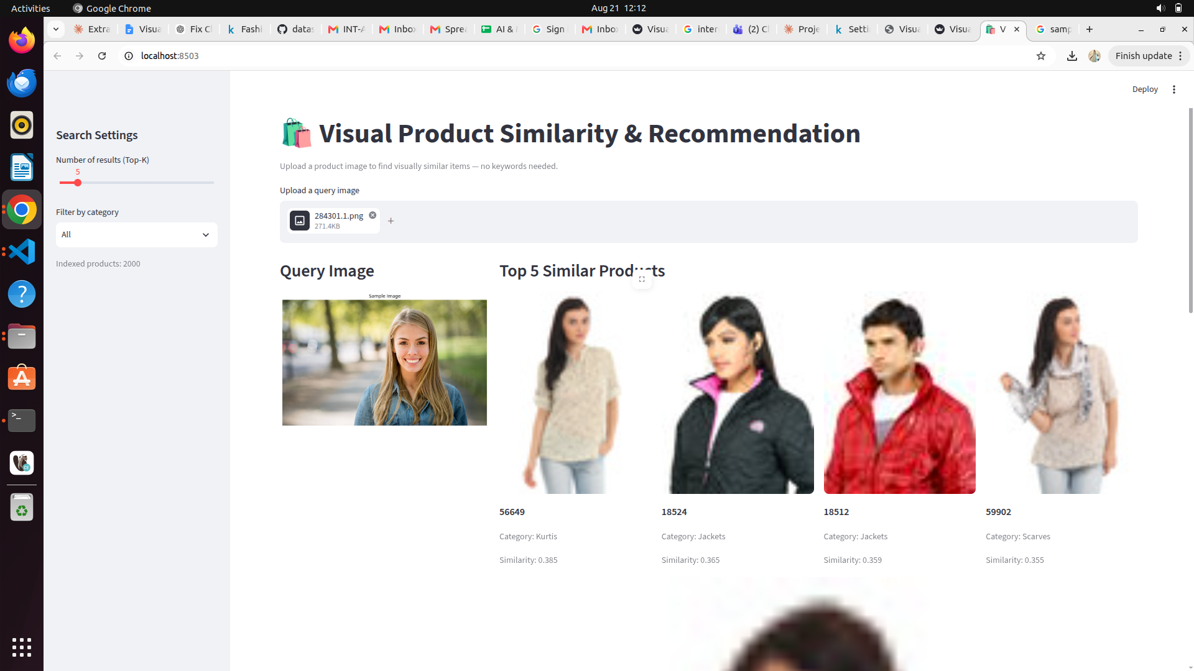
Live Application — Streamlit Demo
Visual Product Similarity & Image-Based Recommendation System
Lakshana Murugesan

Slide 11
Conclusion
A complete, working, computer-vision-based visual product recommendation pipeline — covering dataset preparation, deep learning feature extraction, vector indexing, quantitative evaluation, and an interactive user-facing application.
Achieved Precision@5 of 0.6676 on a real, industry-standard product image dataset.
Thank You
Lakshana Murugesan

